Slide 1
Progress Report
Group 14: Gabe Morey, Luay Alshawi, Chris Johnson

Slide 2
Gabe

Slide 3

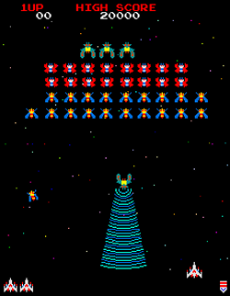
Project Purpose
Create a neural network to play Galaga
Provide a recreatable project as a learning tool for others
Run the project on a Jetson TX1
Working with NVIDIA
Project will be turned into a course for their Deep Learning Institute

Slide 4
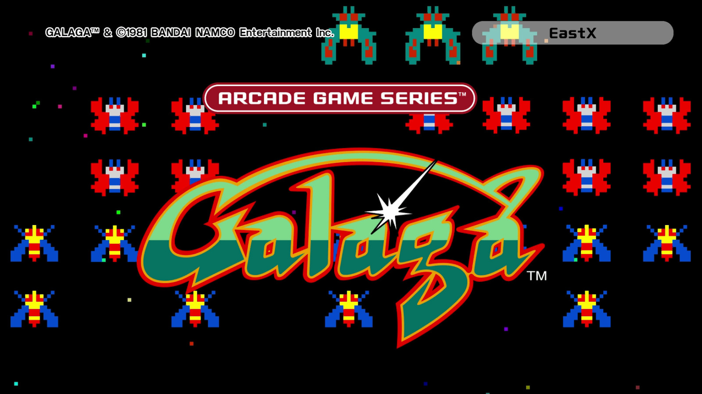
Project Goals
90% completion rate for the first level
Clear and precise documentation of project setup
Ability to learn and improve as it plays the game

Slide 5

Neural Network Framework
Caffe
Uses command line interface
Mathematical formulations and transformations
Able to integrate with Python

Slide 6
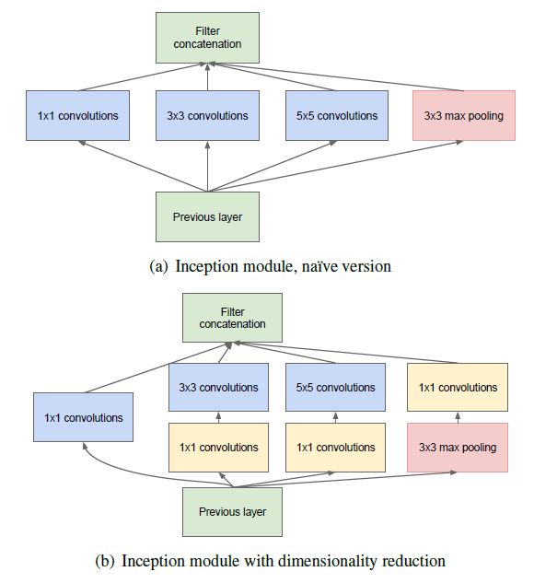
Neural Network Architecture
GoogLeNet
Inception architecture
22 layers deep
100 layers to construct

Slide 7

DIGITS
User Interface for defining neural network properties
Controls network configuration for the user
Allows for easier training

Slide 8
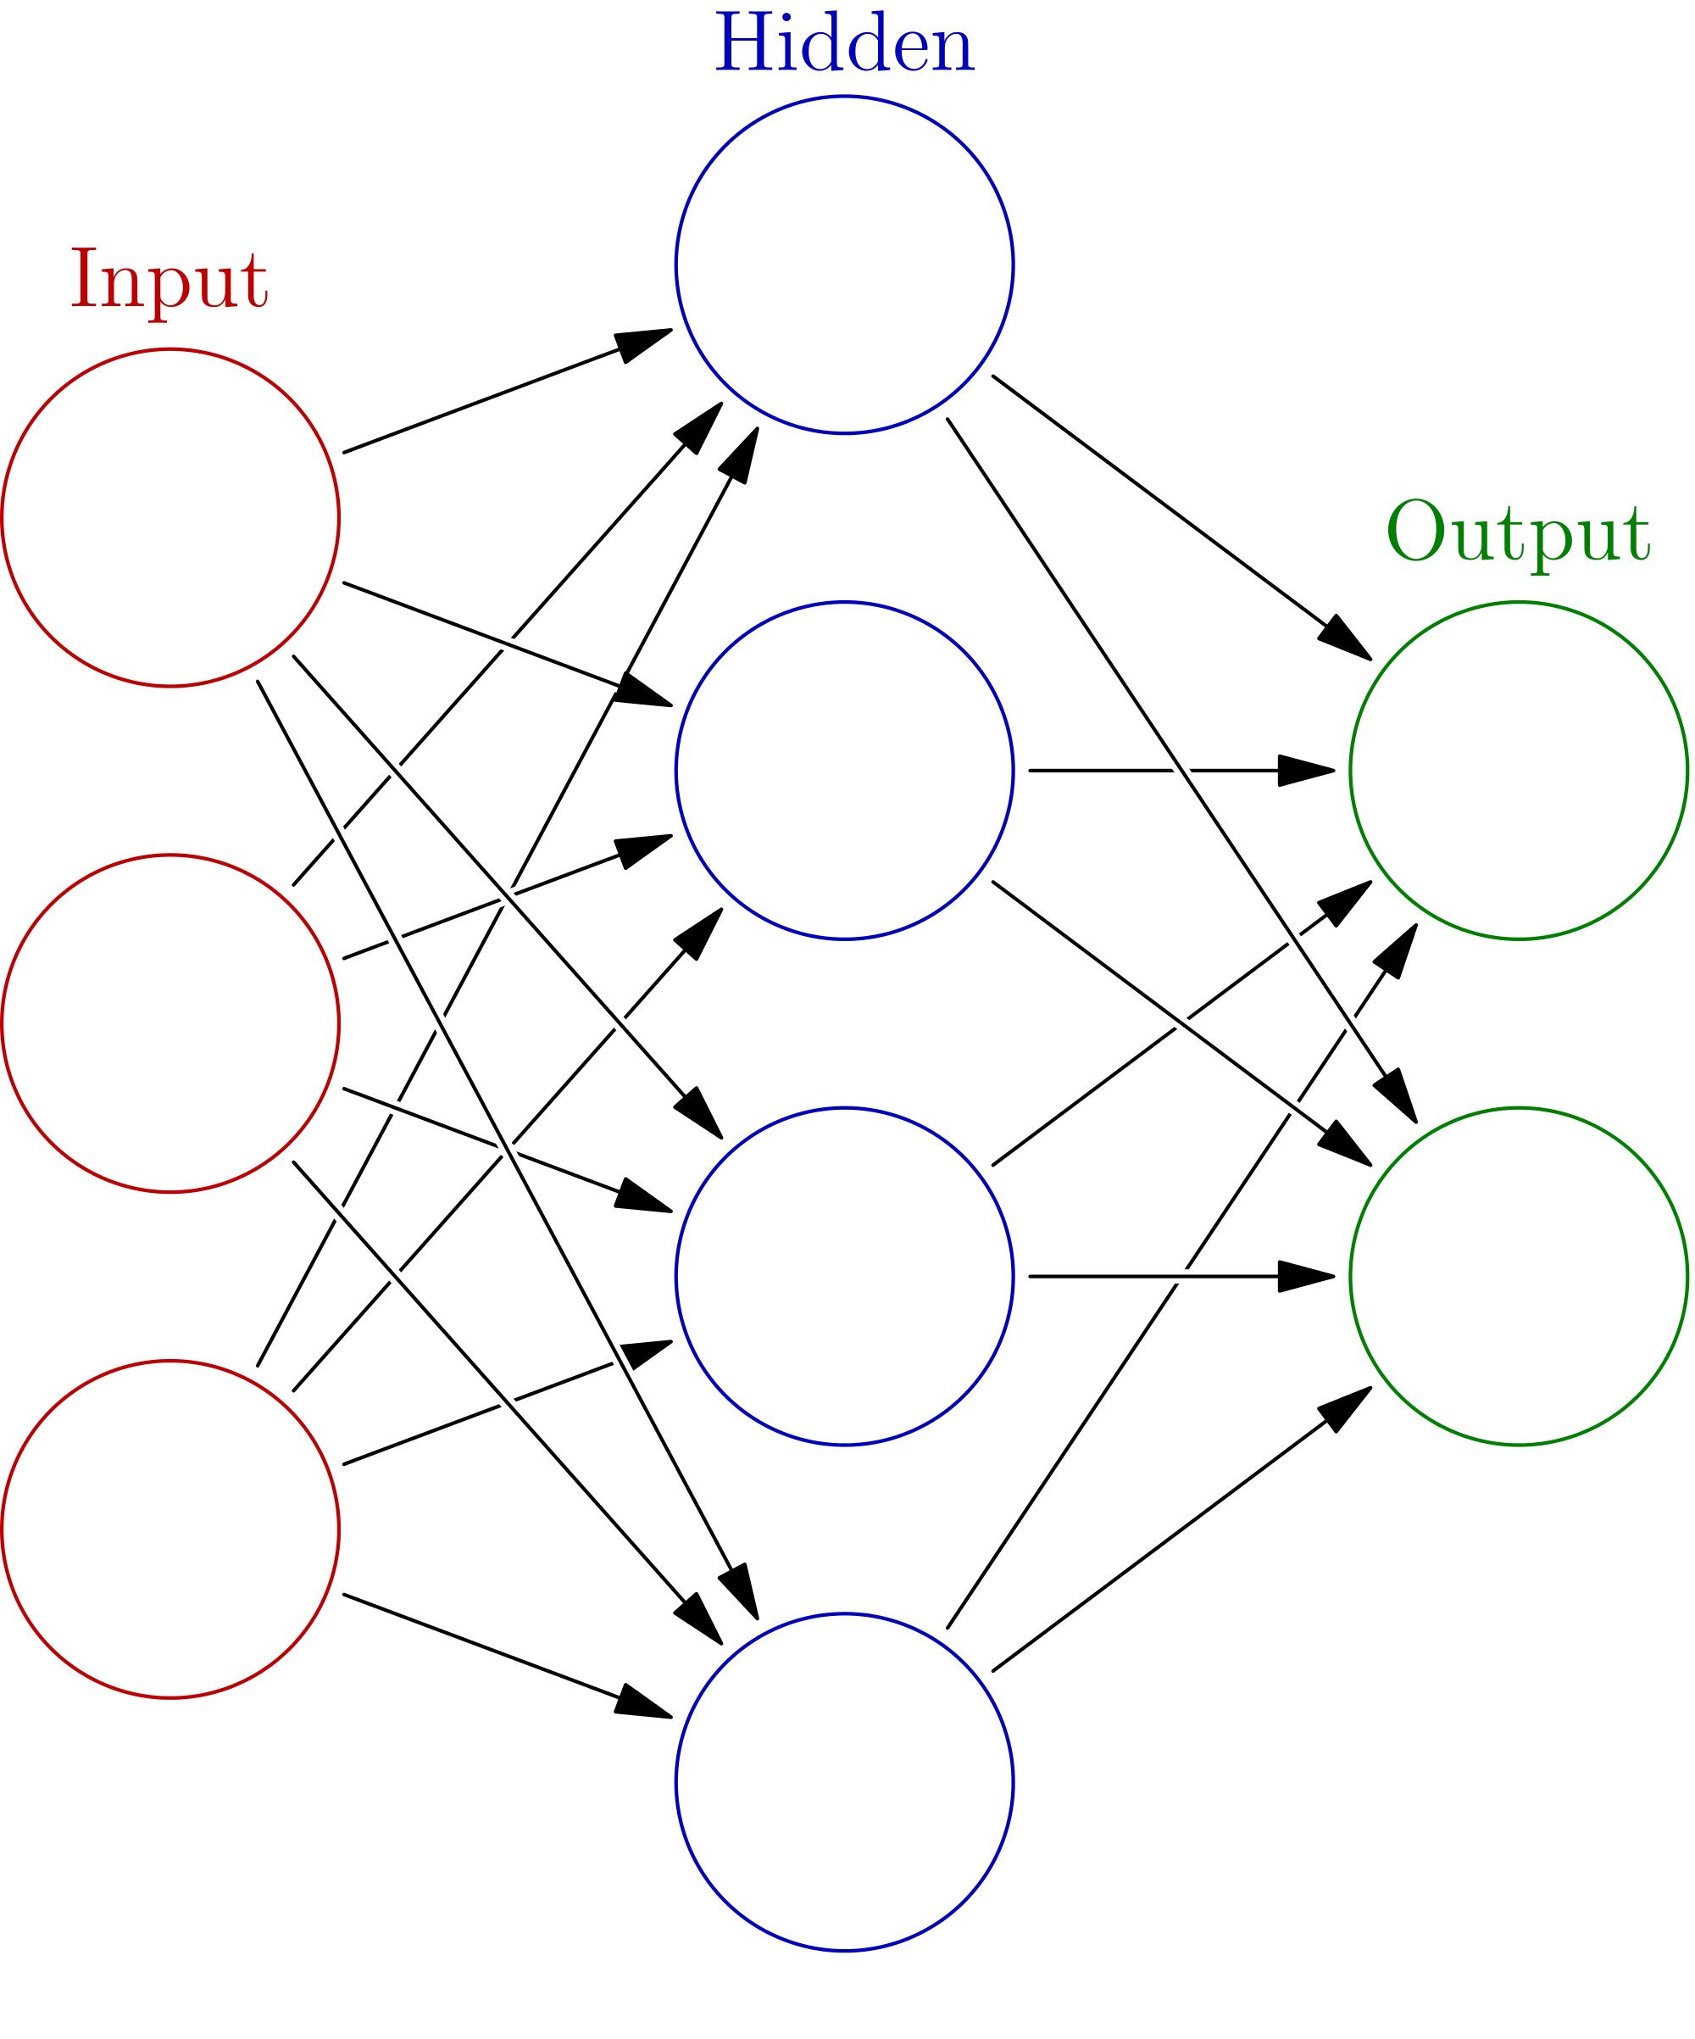
Training Stages
Stage 1: Image Recognition
Train system to recognize in game objects
Stage 2: Reaction
Give system control of the game
Use positive and negative feedback to train it

Slide 9
Luay

Slide 10
Image processing Overview
Three phases:
Image collections
Train neural network (needs label and set of images)
Start video capture of the game playing
Plays important role on this project.
Image processing will be used at the first phase of the project as well as the last phase.

Slide 11
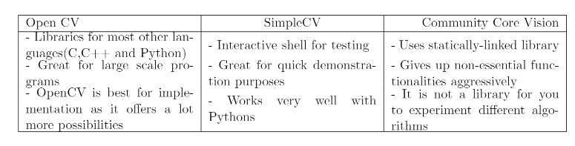
Available tools for image processing
OpenCV
Community Core Vision “CCV”
SimpleCV

Slide 12
Why do we need to use image processing tool?
Reduce all images to one size.
Reduce colors on images.
Image maniplulation in general.
Camera can be used to start video capture while the game playing.

Slide 13
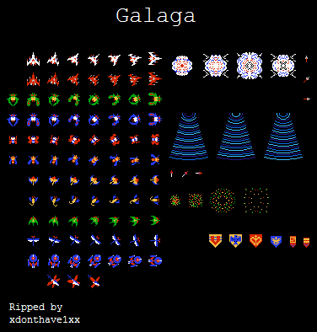
Image collections – First Phase
We should have all the possible shapes for each object.

Slide 14
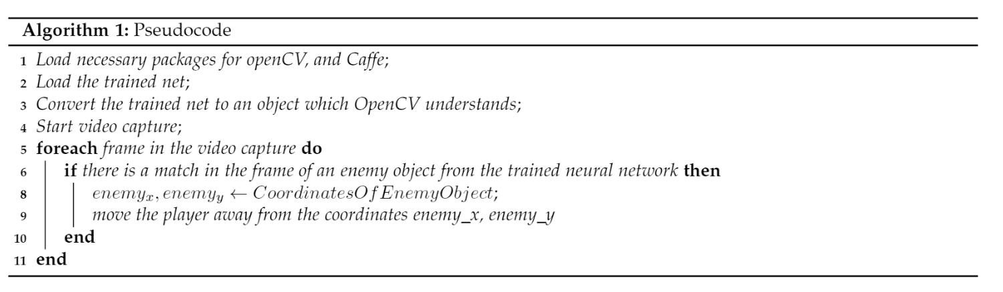
Third Phase – while the game is playing

Slide 15
Chris

Slide 16

Data Visualization
Compact and robust
Use of graphs and visual aids
Summary of data after each playthrough
Will include
How long
Levels completed
How long each level
Enemies destroyed
Greatest weakness
Efficiently compiling all the data

Slide 17
Physical Setup
How all the materials are put together
How everything works together

Slide 18
Hardware Setup
Our project needed several pieces of hardware
Jetson TX1
Gaming controller
Camera
And other items such as a monitor and computer for the game

Slide 19
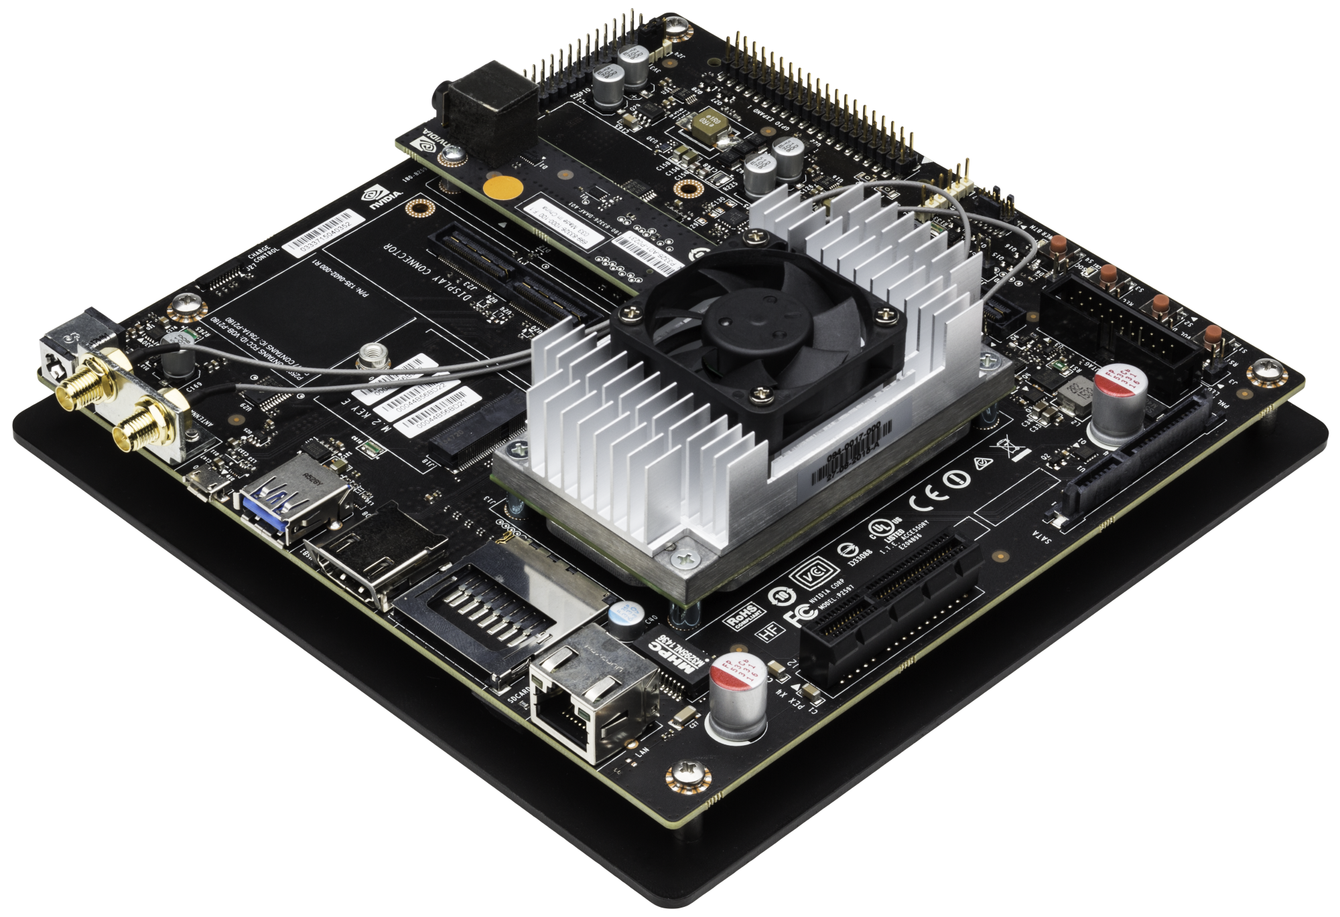
Jetson TX1
Sent to us by client
Embedded system
Designed for power efficiency
Deep learning
Hooked up to
Camera
Controller
Will run the neural net

Slide 20
Camera
Sent to us by client
Records monitor and is hooked up to Jetson
Captures the video output as input for neural net
How neural net will learn
The neural net will recognize game elements
Data from live gameplay will be stored in tables
Neural net will be able to react based on tables

Slide 21
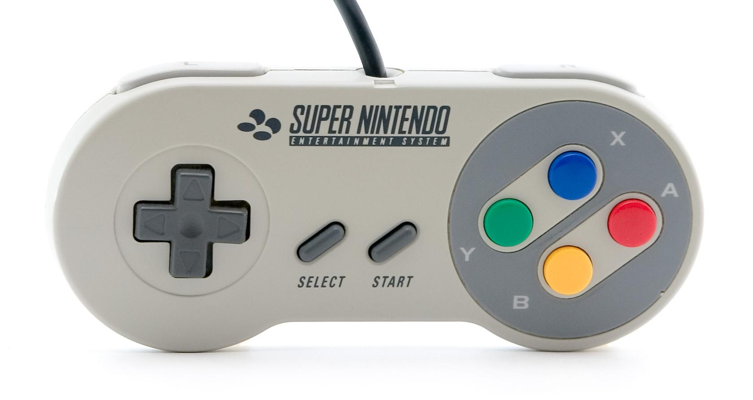
Controller
Controls the game
Used by the neural net to play the game
Still not sure which controller to get
Might have to buy one

Slide 22
Progress Plans and Problems

Slide 23

Progress
So far during our project
Discuss with our client
Build the documentation
Come up with a plan
Obtain some of the material that we need

Slide 24

Plans
For the future of the project
Do more research
Talk to people
Start working on the project over winter break
Build the neural net
Start training

Slide 25
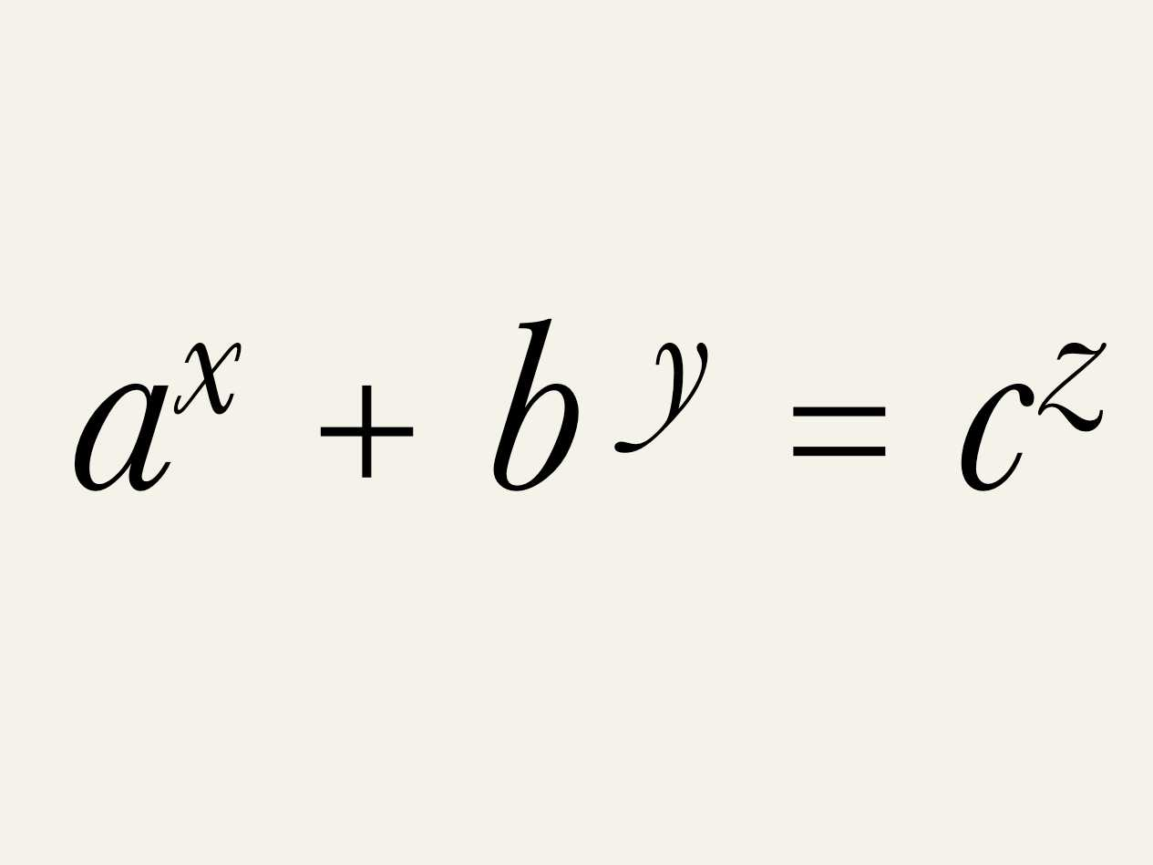
Problems
Roadblocks that we’ve run into
Vague project in the beginning
Time stretches
Busy schedules
Mismatched schedules
Busy client
Not a lot of time between deadlines
Research heavy project

Slide 26
Weekly Progress
Week 1: Learning about capstone
Week 2: Project Assignments
Week 3: Contact client, problem statement
Week 4: Problem Statement work, contact troubles
Week 5: Problem Statement complete, project decided
Week 6: Catching up, requirements doc
Week 7: Requirements revision
Week 8: Tech Review
Week 9: Short week, Design doc discussion
Week 10: Completed Design Doc

